Slide 2
Optimization of production planning with resource allocation
Florian Knop
Pierre Schaus, Charles Thomas
2018-2019
Hélène Verhaeghe

Slide 3
The Village N°1 Problem
Production planning with multiple time periods
1 period = 1 day
Assign workers to demands such that all requirements are satisfied
Demands
Set of periods
Required number of workers (per period)
Skills requirements
Machines/Location
Supervisor
Workers
Set of availabilities
Set of skills
List of incompatibilities with workers / clients

Slide 4
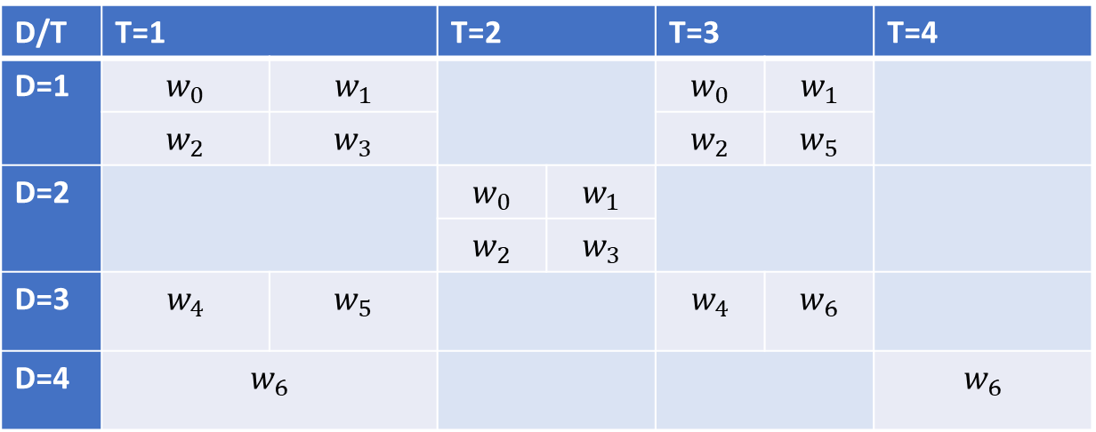
The Village N°1 Problem
D/T | T=1 |  | T=2 |  | T=3 |  | T=4
D=1 | $$w_{0}$$ | $$w_{1}$$ |  |  | $$w_{0}$$ | $$w_{1}$$
 | $$w_{2}$$ | $$w_{3}$$ |  |  | $$w_{2}$$ | $$w_{5}$$
D=2 |  |  | $$w_{0}$$ | $$w_{1}$$
 |  |  | $$w_{2}$$ | ${ w}_{3}$
D=3 | $$w_{4}$$ | $$w_{5}$$ |  |  | $$w_{4}$$ | $$w_{6}$$
D=4 | $$w_{6}$$ |  |  |  |  |  | $$w_{6}$$

Slide 5
Hard Constraints
A worker cannot work when not available
A worker cannot be assigned when a demand is not occuring
A worker cannot be assigned twice in the same period
Incompatibilities
Worker/worker
Worker/client
Skill restriction
Required number of workers for each demand

Slide 6
Soft Constraints
Client / Worker preference
Keep worker at the same position for the duration of the demand
Minimum/Maximum shifts for a worker
A solution is not always possible:
Sentinel worker
Minimize the number of times this « worker » is assigned
Objective:
Minimize the number of violations and the number of worker changes in demands

Slide 7
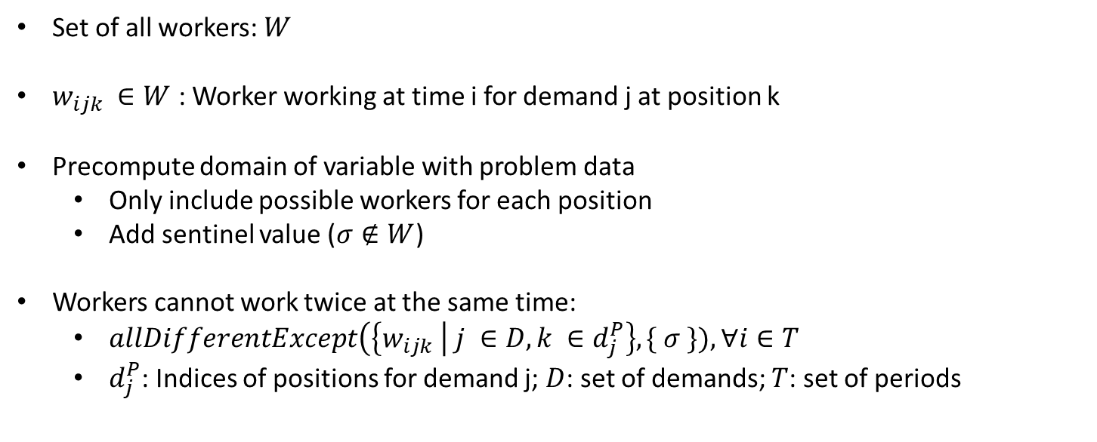
Constraint Programming Model
Set of all workers: $W$
$w_{ijk} ∈W$ : Worker working at time i for demand j at position k
Precompute domain of variable with problem data
Only include possible workers for each position
Add sentinel value ($σ∉W$)
Workers cannot work twice at the same time:
$allDifferentExcept\left(\left\{w_{ijk} \right| j ∈D, k ∈d_{j}^{P}\right\}, \{ σ \}), ∀i∈T$
$d_{j}^{P}$: Indices of positions for demand j; $D$: set of demands; $T$: set of periods

Slide 8
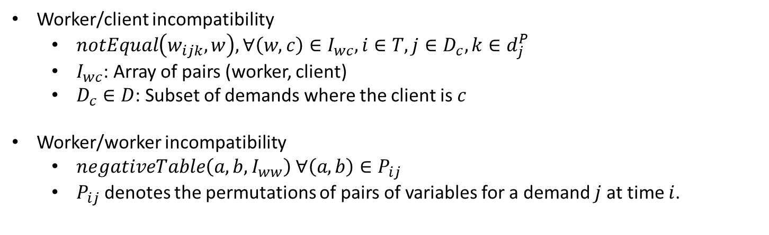
Constraint Programming Model
Worker/client incompatibility
$notEqual\left(w_{ijk}, w\right), ∀\left(w, c\right)∈I_{wc}, i∈T, j∈D_{c}, k∈d_{j}^{P}$
$I_{wc}$: Array of pairs (worker, client)
$D_{c}∈D$: Subset of demands where the client is $c$
Worker/worker incompatibility
$negativeTable\left(a, b, I_{ww}\right) ∀\left(a, b\right)∈P_{ij}$
$P_{ij}$ denotes the permutations of pairs of variables for a demand $j$ at time $i$.

Slide 9
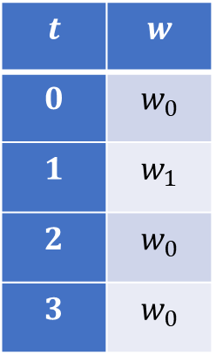
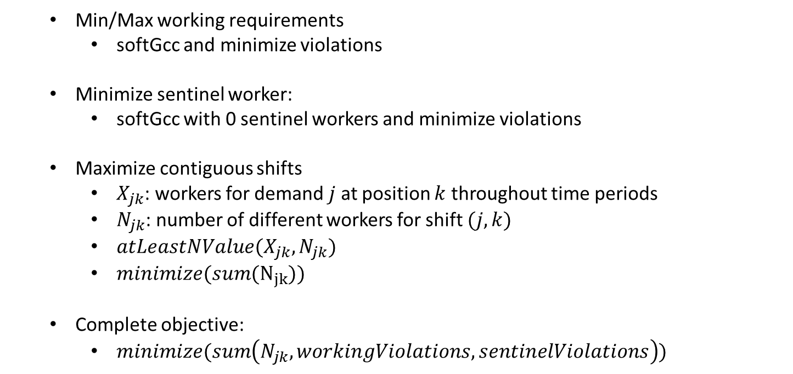
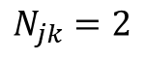
Constraint Programming Model
Min/Max working requirements
softGcc and minimize violations
Minimize sentinel worker:
softGcc with 0 sentinel workers and minimize violations
Maximize contiguous shifts
$X_{jk}$: workers for demand $j$ at position $k$ throughout time periods
$N_{jk}$: number of different workers for shift $(j, k)$
$atLeastNValue(X_{jk}, N_{jk})$
$minimize(sum(N_{jk}))$
Complete objective:
$minimize(sum\left(N_{jk}, workingViolations, sentinelViolations\right))$
$$t$$ | $$w$$
$$0$$ | $$w_{0}$$
$$1$$ | $$w_{1}$$
$$2$$ | $$w_{0}$$
$$3$$ | $$w_{0}$$
$$N_{jk}=2$$

Slide 10
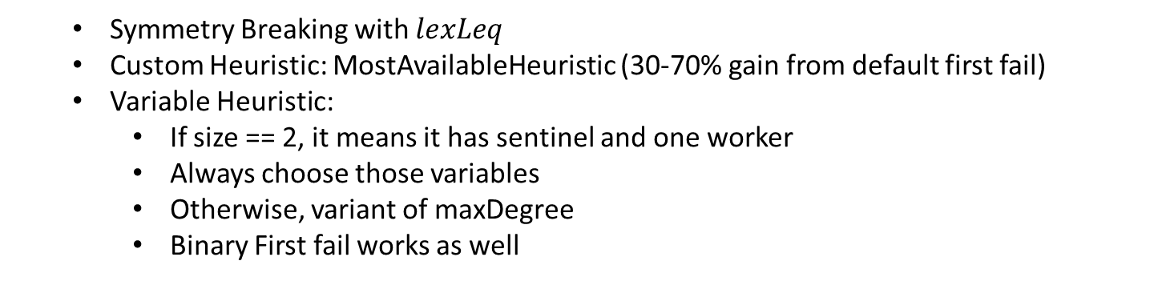
Constraint Programming Search
Symmetry Breaking with $lexLeq$
Custom Heuristic: MostAvailableHeuristic (30-70% gain from default first fail)
Variable Heuristic:
If size == 2, it means it has sentinel and one worker
Always choose those variables
Otherwise, variant of maxDegree
Binary First fail works as well

Slide 11
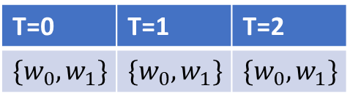
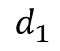
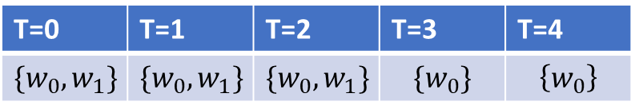
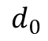
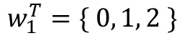
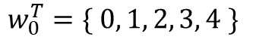
Constraint Programming Search
Value heuristic
Order the workers from most available to least available
Second ordeing (if availabilities are equal)
Order from the least available for other demands to the most available for other demands
$$w_{0}^{T}=\{ 0, 1, 2, 3, 4 \}$$
$$w_{1}^{T}=\{ 0, 1, 2 \}$$
T=0 | T=1 | T=2 | T=3 | T=4
$$\{w_{0},w_{1}\}$$ | $$\{w_{0},w_{1}\}$$ | $$\{w_{0},w_{1}\}$$ | $$\{w_{0}\}$$ | $$\left\{w_{0}\right\}$$
$$d_{0}$$
$$mostAvailable\left(d_{0}\right)=[w_{0}=(5, 0), w_{1}=(3,0)]$$
$$mostAvailable\left(d_{1}\right)=[w_{1}=(3, 0), w_{0}=(3,2)]$$
T=0 | T=1 | T=2
$$\{w_{0},w_{1}\}$$ | $$\{w_{0},w_{1}\}$$ | $$\{w_{0},w_{1}\}$$
$$d_{1}$$

Slide 12
Constraint Programming Search
Large Neighborhood Search
Random Relaxation (50%)
Increase failure limit when not finding solution

Slide 13
Mixed Integer Programming
$w_{ijkl}=\left\{\begin{aligned}&1, if worker i is working at time j for demand k at position l \\ &0, otherwise\end{aligned}\right.$
$s_{jkl} =\left\{\begin{aligned}&1, if no worker is assigned to position l for demand k at time j \\ &0, otherwise\end{aligned}\right.$

Slide 14
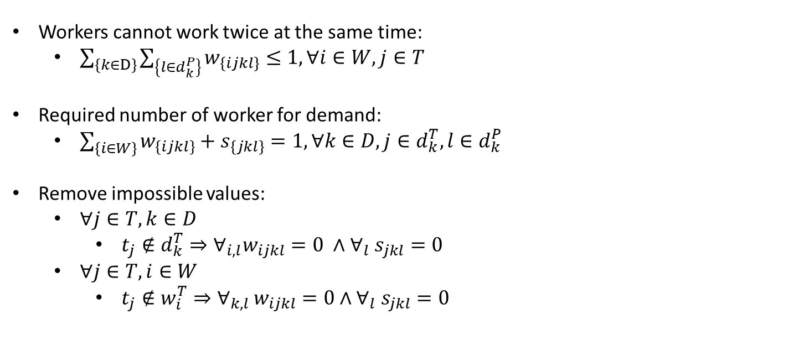
Mixed Integer Programming
Workers cannot work twice at the same time:
$\sum_{\left\{k∈D\right\}}{\sum_{\left\{l∈d_{k}^{P}\right\}}{w_{\left\{ijkl\right\}}≤1, ∀i∈W, j∈T}}$
Required number of worker for demand:
$\sum_{\left\{i∈W\right\}}{w_{\left\{ijkl\right\}}+s_{\left\{jkl\right\}}}=1, ∀k∈D, j∈d_{k}^{T}, l∈d_{k}^{P}$
Remove impossible values:
$∀j∈T,k∈D$
$t_{j}∉d_{k}^{T}⇒∀_{i,l}w_{ijkl}=0 ∧∀_{l} s_{jkl}=0$
$∀j∈T, i∈W$
$t_{j}∉w_{i}^{T}⇒∀_{k,l }w_{ijkl}=0∧∀_{l} s_{jkl}=0$

Slide 15
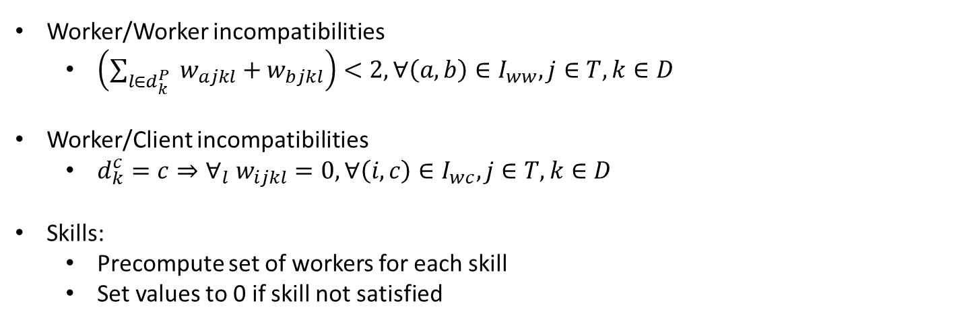
Mixed Integer Programming
Worker/Worker incompatibilities
$\left(\sum_{l∈d_{k}^{P}}{ w_{ajkl}+w_{bjkl}}\right)<2, ∀\left(a,b\right)∈I_{ww}, j∈T, k∈D$
Worker/Client incompatibilities
$d_{k}^{c}=c⇒∀_{l} w_{ijkl}=0, ∀\left(i, c\right)∈I_{wc}, j∈T, k∈D$
Skills:
Precompute set of workers for each skill
Set values to 0 if skill not satisfied

Slide 16
Implementation
OscaR & Gurobi
Scala
Json Schema for problem/solution definition

Slide 17
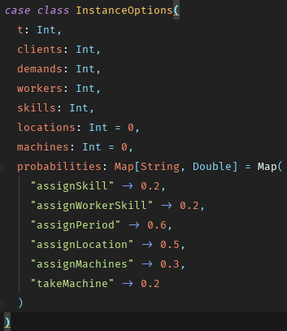
Instance Generator
No Real data
Generate data randomly
Ensure it is always feasible

Slide 18
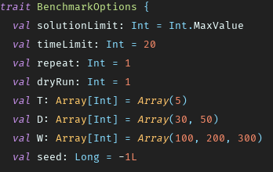
Benchmark
Parameterized benchmark
Run on Ingi machines via StudSSH

